Slide 1







Random Variable
Santosh Chhatkuli

Slide 2
Terminology
Random Experiment: Any action that can have more than one possible outcome (result) is called random experiment.
Sample Space: Representation of every possible outcome (result) of a random experiment is called sample space. It is denoted by ‘S’.
Random Variable: A random variable X is a variable whose values are numerical outcomes of random phenomenon. Random variable quantifies outcome of random experiment.
Mathematically, a random variable X is a function whose domain is the sample space and whose range is the set of real numbers. So random variable maps possible outcomes of random experiment to set of real numbers.
X = f (w)
Range can be set of real numbers or set of integers or set of positive numbers etc.

Slide 3
Types of random variable
A random variable can be discrete or continuous.
Discrete random variable: If random variable is allowed to take on only a limited number of values, which can be listed, then it is a discrete random variable. It can assume only a countable number of values.
Continuous random variable: If a random variable is takes infinite number of values within a given range, it is a continuous random variable.
Probability Distribution:
Probability distribution is the listing of all possible outcomes of an experiment together with their probabilities. Probability distribution describes the dispersion of the values of a random variable.
There are two types of probability distributions
Discrete probability distribution: A probability distribution of a discrete random variable
Continuous probability distribution: A probability distribution of continuous random variable.
Some of the probability distribution can be modeled and are called probability distribution function. A probability distribution function is the mathematical function that gives the probabilities of occurrence of different possible outcomes for an experiment.

Slide 4
Example 1 : Consider tossing a coin three times ( or simultaneous tossing of three coins)
No. of possible outcomes = 2^3 = 8
Sample space (S) = {HHH, HHT, HTT, HTH, THT, THH, TTH, TTT}
Define the random variable ‘X’ as follows.
X = No. of heads in the sequence
The r.v. X can take values 0, 1, 2, 3
The probability distribution for this process is:
Outcomes | HHH | HHT | HTT | HTH | THT | THH | TTH | TTT
X = No. of heads | 3 | 2 | 1 | 2 | 1 | 2 | 1 | 0
Probability | 1/8 | 1/8 | 1/8 | 1/8 | 1/8 | 1/8 | 1/8 | 1/8

Slide 5
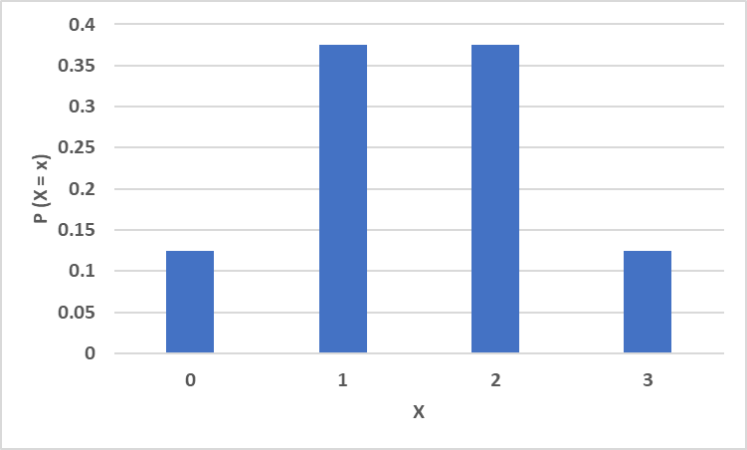
The table can be summarized as follows
This is an example of discrete probability distribution. The probability distribution of X is a Binomial Probability Distribution.
P (X = x) = nCx . p^{x} . q^{n-x}
P (X = 0) = 3C0 (0.5)^0 * (0.5)^3-0 = 1/8 = 0.125
Similarly we can find the rest of the probabilities.
Notation: n = no. of trials, x = no. of successes, n – x = no. of failures
p = probability of success, q = probability of failure
X | P ( X = x ) | X. P(X=x)
0 | 1/8 | 0
1 | 3/8 | 3/8
2 | 3/8 | 6/8
3 | 1/8 | 3/8
Total | 1 | 1.5

Slide 6
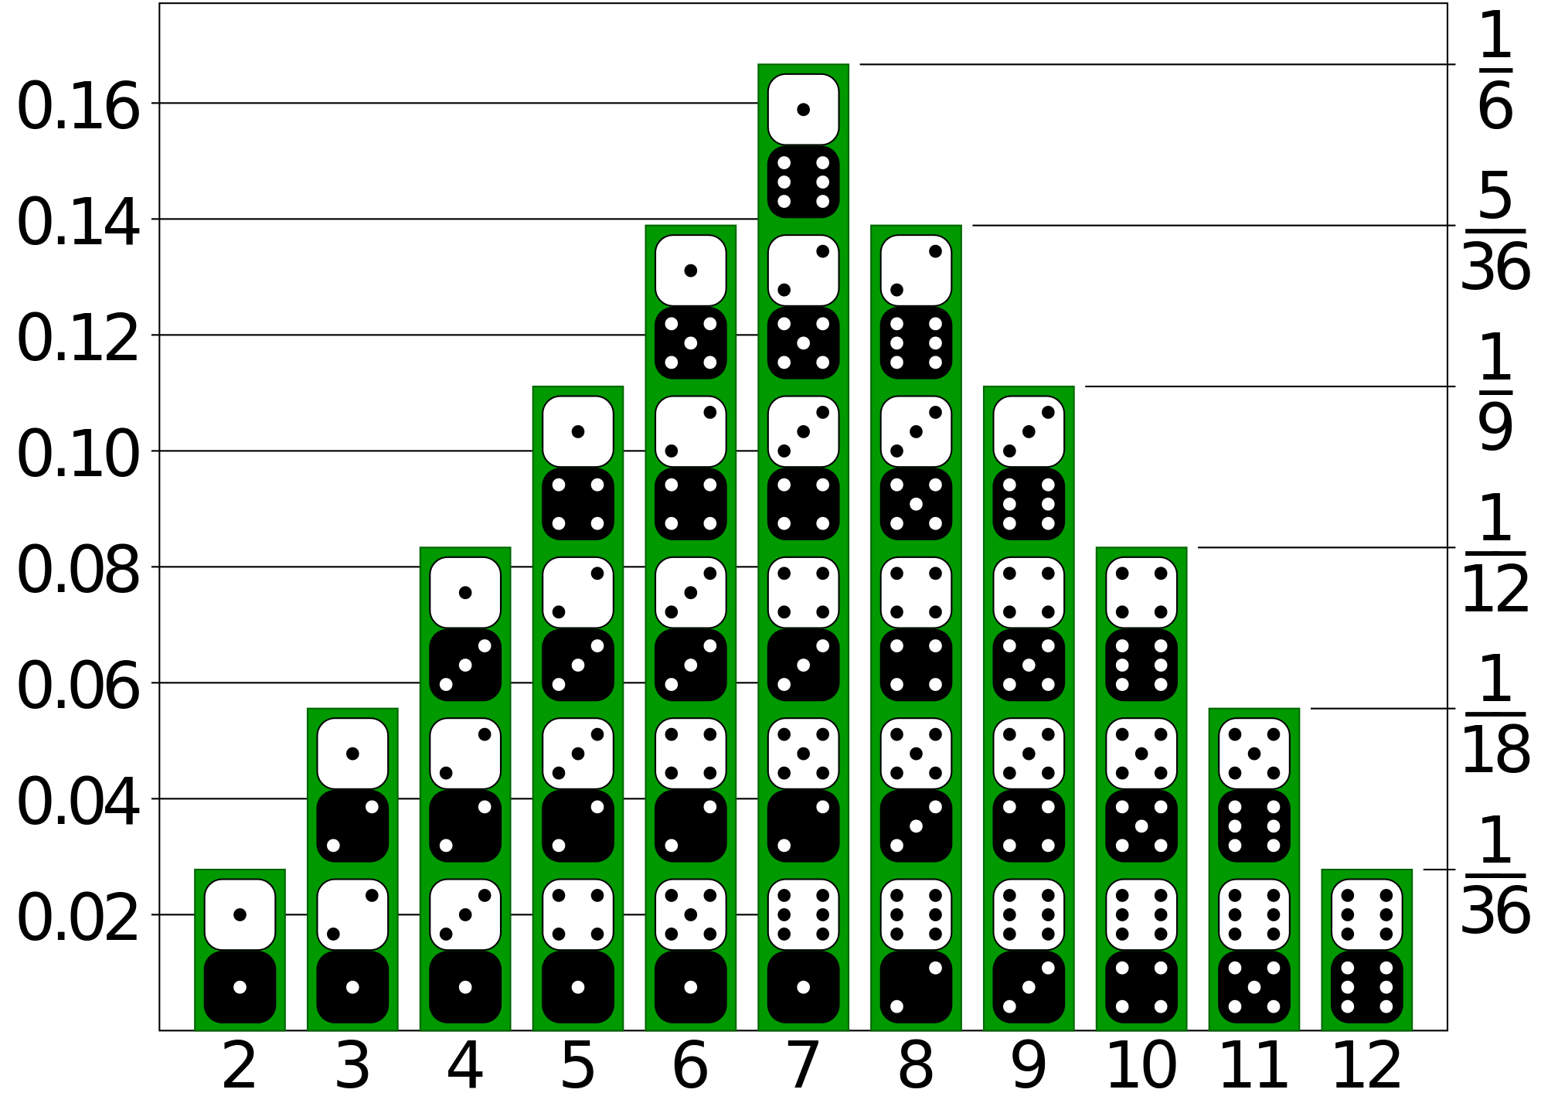
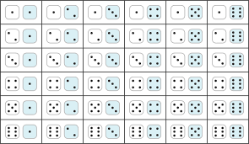
Example 2: Consider rolling two fair dice simultaneously.
No. of possible outcomes = 6^2 = 36
Sample space is:
Let, r.v. X = Sum of numbers appear in the face of
dice when rolled. The r.v. variable X is discrete and
it takes value from 2 to 12.
The probability distribution for this action is:
X = Sum of nobs | 2 | 3 | 4 | 5 | 6 | 7 | 8 | 9 | 10 | 11 | 12
No. of outcomes | 1 | 2 | 3 | 4 | 5 | 6 | 5 | 4 | 3 | 2 | 1
Probability | 1/36 | 1/18 | 1/12 | 1/9 | 5/36 | 1/36 | 5/36 | 1/9 | 1/12 | 1/18 | 1/36

Slide 7
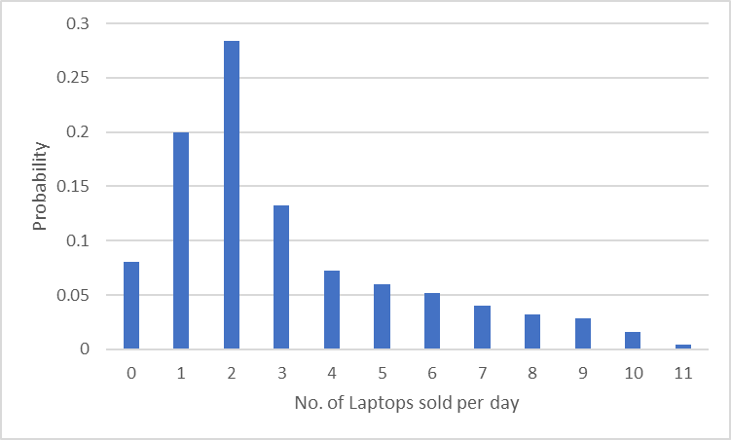
Example 3: Using the company record of past 500 working days, the manager of IT stores has summarized the number of Laptops sold per day into the following table.
In this case random variable X = No. of Laptops sold per day (X = 0, 1, …, 11)
No. of Laptops sold per day | 0 | 1 | 2 | 3 | 4 | 5 | 6 | 7 | 8 | 9 | 10 | 11 | Total
No. of days | 40 | 100 | 142 | 66 | 36 | 30 | 26 | 20 | 16 | 14 | 8 | 2 | n = 500
Probability | 0.08 | 0.2 | 0.284 | 0.132 | 0.072 | 0.06 | 0.052 | 0.04 | 0.032 | 0.028 | 0.016 | 0.004 | 1

Slide 8
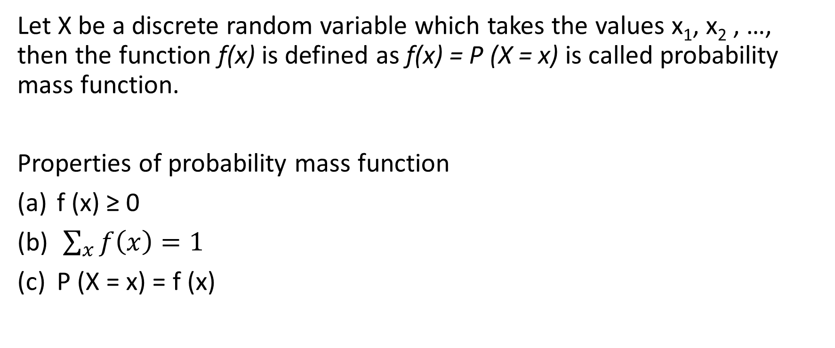
Probability mass function
Let X be a discrete random variable which takes the values x₁, x₂ , …, then the function f(x) is defined as f(x) = P (X = x) is called probability mass function.
Properties of probability mass function
f (x) ≥ 0
$\sum_{x}{f\left(x\right)=1}$
P (X = x) = f (x)

Slide 9
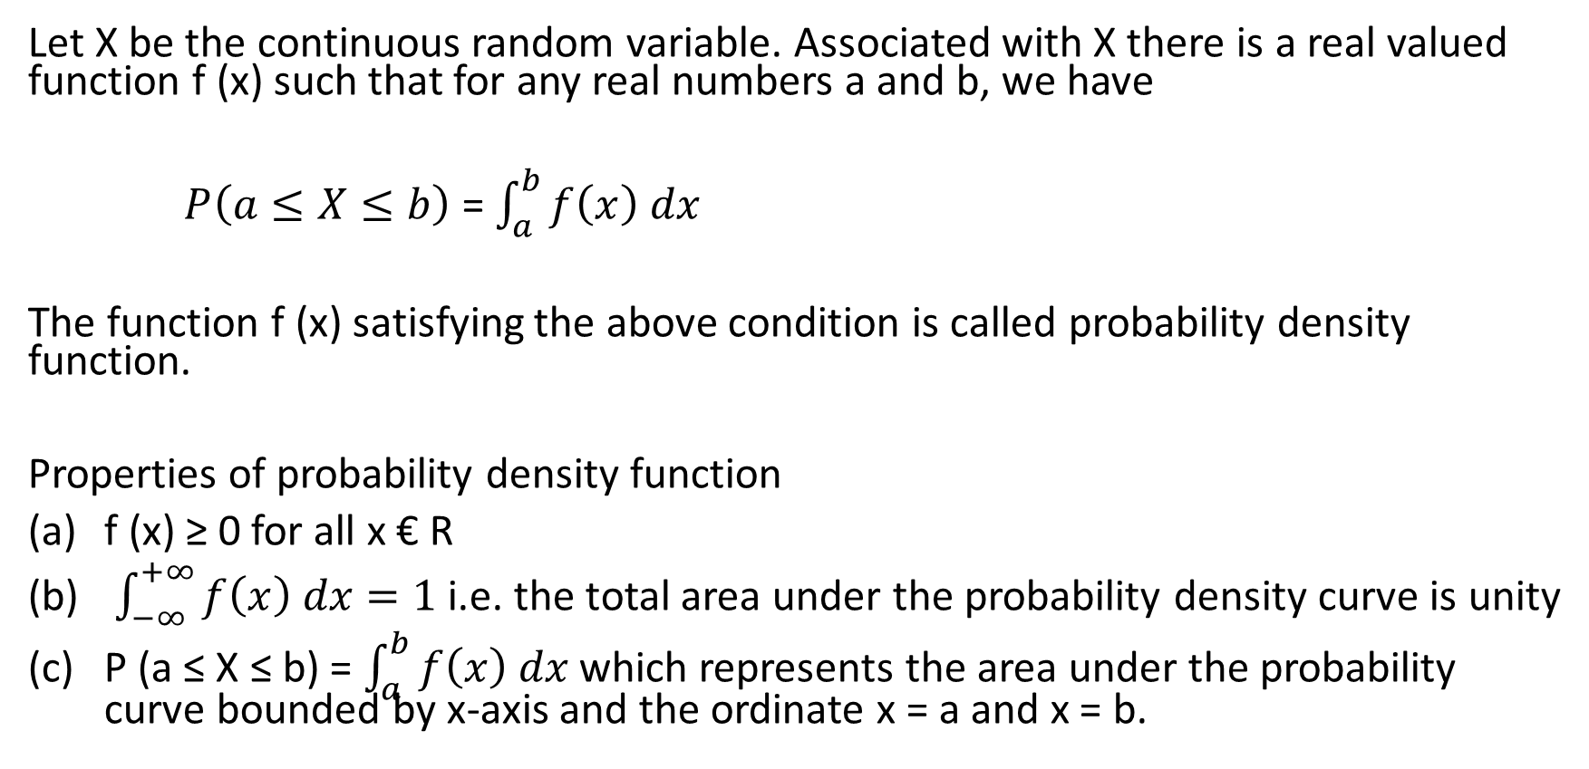
Probability density function
Let X be the continuous random variable. Associated with X there is a real valued function f (x) such that for any real numbers a and b, we have
$P\left(a≤X≤b\right)$ = $\int_{a}^{b}{f\left(x\right) dx}$
The function f (x) satisfying the above condition is called probability density function.
Properties of probability density function
f (x) ≥ 0 for all x € R
$\int_{−∞}^{+∞}{f\left(x\right) dx=1}$ i.e. the total area under the probability density curve is unity
P (a ≤ X ≤ b) = $\int_{a}^{b}{f\left(x\right) dx}$ which represents the area under the probability curve bounded by x-axis and the ordinate x = a and x = b.

Slide 10
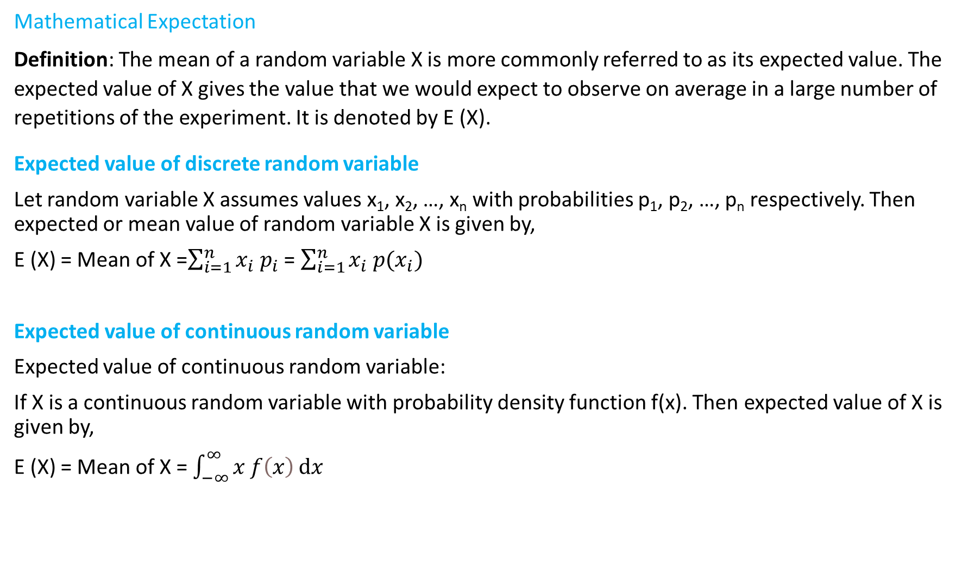
Expected value of random variable (Mathematical Expectation)
Mathematical Expectation
Definition: The mean of a random variable X is more commonly referred to as its expected value. The expected value of X gives the value that we would expect to observe on average in a large number of repetitions of the experiment. It is denoted by E (X).
Expected value of discrete random variable
Let random variable X assumes values x₁, x₂, …, x_{n} with probabilities p₁, p₂, …, p_{n} respectively. Then expected or mean value of random variable X is given by,
E (X) = Mean of X =$\sum_{i=1}^{n}{x_{i}{ p}_{i}}$ = $\sum_{i=1}^{n}{x_{i} p(x_{i})}$
Expected value of continuous random variable
Expected value of continuous random variable:
If X is a continuous random variable with probability density function f(x). Then expected value of X is given by,
E (X) = Mean of X = $\int_{−∞}^{∞}{x f\left(x\right)ⅆx}$

Slide 11
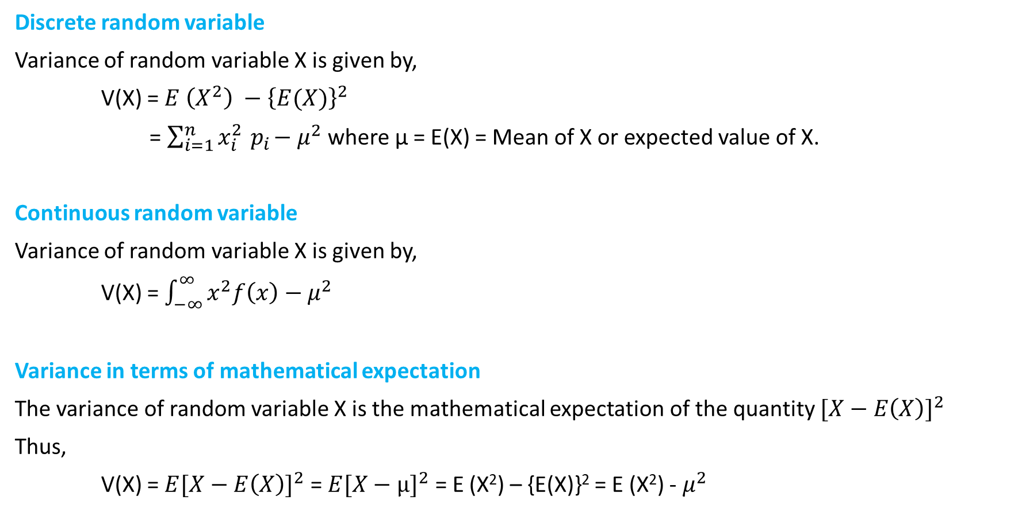
Variance of random variable
Discrete random variable
Variance of random variable X is given by,
V(X) = $E \left(X^{2}\right) −{\left\{E(X)\right\}}^{2}$
= $\sum_{i=1}^{n}{x_{i}^{2}{ p}_{i}−μ^{2}}$ where µ = E(X) = Mean of X or expected value of X.
Continuous random variable
Variance of random variable X is given by,
V(X) = $\int_{−∞}^{∞}{x^{2}f\left(x\right)−μ^{2}}$
Variance in terms of mathematical expectation
The variance of random variable X is the mathematical expectation of the quantity ${[X−E\left(X\right)]}^{2}$
Thus,
V(X) = ${E[X−E\left(X\right)]}^{2}$ = ${E[X−µ]}^{2}$ = E (X²) – {E(X)}² = E (X²) - $μ^{2}$

Slide 12
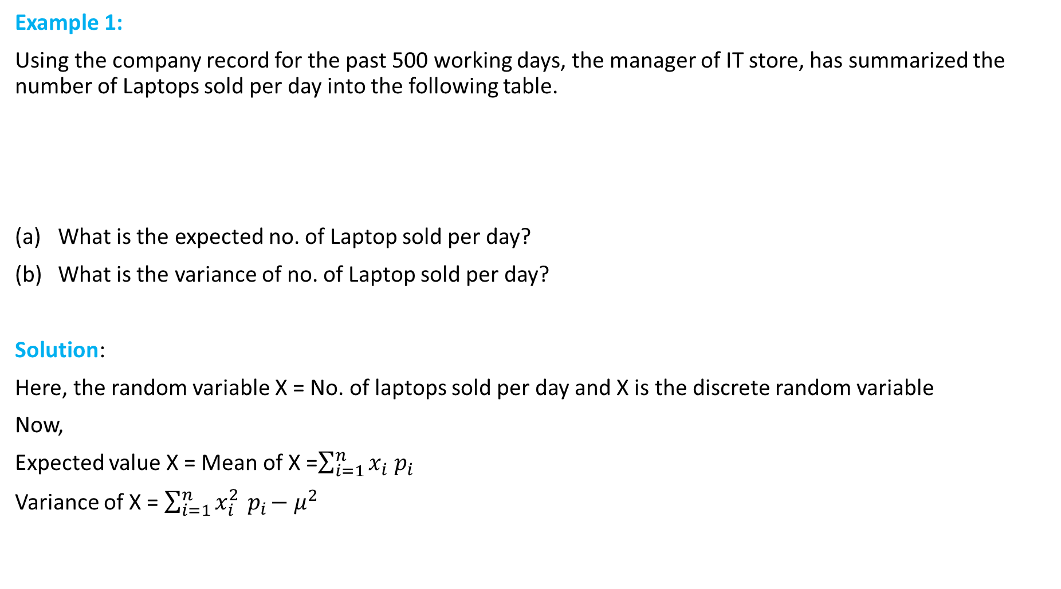
Example 1:
Using the company record for the past 500 working days, the manager of IT store, has summarized the number of Laptops sold per day into the following table.
What is the expected no. of Laptop sold per day?
What is the variance of no. of Laptop sold per day?
Solution:
Here, the random variable X = No. of laptops sold per day and X is the discrete random variable
Now,
Expected value X = Mean of X =$\sum_{i=1}^{n}{x_{i}{ p}_{i}}$
Variance of X = $\sum_{i=1}^{n}{x_{i}^{2}{ p}_{i}−μ^{2}}$
No. of laptop sold per day | 0 | 1 | 2 | 3 | 4 | 5 | 6 | 7 | 8 | 9 | 10 | 11 | Total
No. of days | 40 | 100 | 142 | 66 | 36 | 30 | 26 | 20 | 16 | 14 | 8 | 2 | n = 500

Slide 13
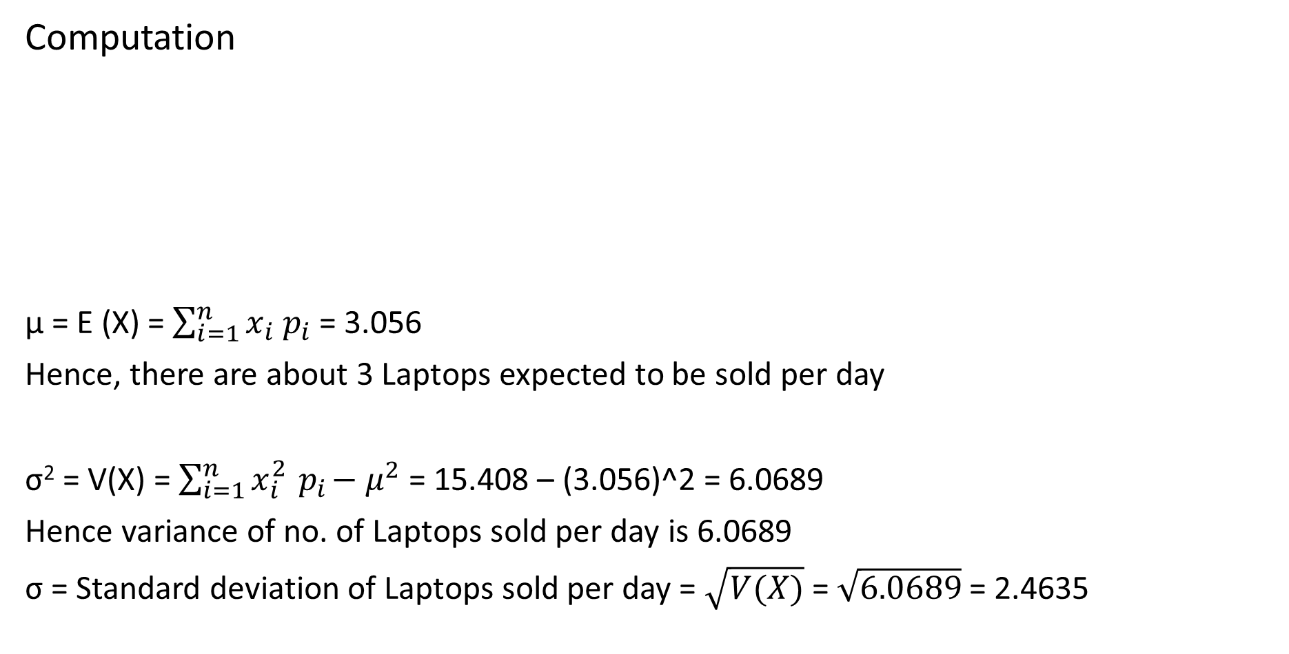
Computation
µ = E (X) = $\sum_{i=1}^{n}{x_{i}{ p}_{i}}$ = 3.056
Hence, there are about 3 Laptops expected to be sold per day
σ² = V(X) = $\sum_{i=1}^{n}{x_{i}^{2}{ p}_{i}−μ^{2}}$ = 15.408 – (3.056)^2 = 6.0689
Hence variance of no. of Laptops sold per day is 6.0689
σ = Standard deviation of Laptops sold per day = $\sqrt{V(X)}$ = $\sqrt{6.0689}$ = 2.4635

Slide 14
Rules of Expectation
Rule 1: The expectation of constant is a constant.
E (c) = c
Rule 2: The expectation of scaler multiple of X is equal to scaler times expectation of X i.e. E (c X) = c E(X)
Rule 3: If a and b are constants then
(a) E (a X ± b) = a E(X) ± b
(b) E (a ± b X) = a ± b E(X)
(c) E (a ± X) = a ± E (X)
Rule 4: If X₁ and X₂ are two variables, then
E(X₁ ± X₂) = E (X₁) ± E(X₂)
In general,
E(X₁ ± X₂ ± … ± X_{n}) = E(X₁) ± E(X₂) ± … ± E(X_{n})

Slide 15
Rules of variance
Rule 1: The variance of constant is zero i.e. V (c) = 0
Rule 2: The variance of scaler multiplication of r. v. X is equal to square of scaler times variance of X i.e.
V (c X) = c² . V (X)
Rule 3: If a and b are constants
V (a X ± b) = a² V (X)
E (a ± b X) = b² V (X)
(c) E (a ± X) = V (X)
Rule 4: V (X₁ ± X₂) = V (X₁) + V (X₂) ± 2 COV (X₁, X₂)
V (X₁ + X₂) = V (X₁) + V(X₂) + 2 COV (X₁, X₂)
V (X₁ – X₂) = V (X₁) + V (X₂) - 2 COV (X₁, X₂)
V (aX₁ + bX₂) = a² V (X₁) + b² V(X₂) + 2 ab Cov (X₁, X₂)
Rule 5: If X₁ and X₂ are independent then,
V (X₁ ± X₂) = V(X₁) ± V (X₂)
V(X₁ ± X₂ ± …. ± X_{n}) = V(X₁) ± V(X₂) ± … ± V (X_{n})
Rule 6: However, it is generally NOT TRUE that V(X₁ . X₂) = V(X₁) . V(X₂)
If X₁ and X₂ are independent random variables, then V(X.Y) = E(X²) . E(Y²)
If X1 and X2 are dependent, then V (X₁ . X₂) = E (X²Y²) – {E(XY)}² = E (X²Y²) – { E(X) . E(Y)}²

